Slide 1
BIGHERO5
Gautam Ravichandran | Karankumar Parikh | Ashwin Nair | Victoria Green | Young Jun Son

Slide 2
About Us

Slide 3

The Team
Gautam Ravichandran
Karankumar Parikh
Ashwin Nair
Victoria Green
Young Jun Son
Team Coordinator Java Coder Front-End Developer Documents Handler
Java Coder Database Manager Backend Developer Documentation
Presentation QA Analyst Documentation Java Coder
Java Coder Database Manager GUI Coder/Tester Documentation
Java Coder Documentation User Guide QA Analyst

Slide 4
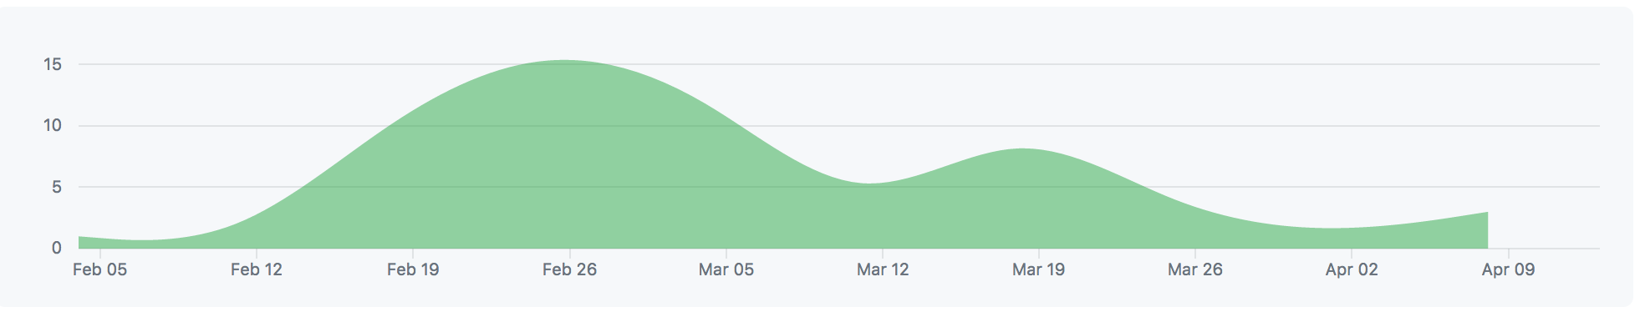
Timeline and Metrics
January | February | March | April
 |  | Implementation
Planning
Code: ~4,000 Lines
Final Report: Pages
Implementation
Finalize

Slide 5

Developmental Tools
Code: Java
GUI: Swing
Database: SQLite
Repository: eGit
IDE : Eclipse

Slide 6
Overview
Purpose: The objective of the software is to make life easier for those who take their time to make our life easier.
We have created a hospital management system which focuses on coordinating the day-to-day functionality of hospital environments so that they will be able to address patient and general hospital needs in a more simplified and organized fashion.

Slide 7
Main Features
Feature 1
Scheduling Appointments
Feature 2
Maintaining Patient and Staff Records
Feature 3
Overseeing Pharmacy Inventory
Feature 4
Processing Patient Invoices

Slide 8
System Model
Our Hospital Management System is conducted in a client-server architecture.
The user’s inputs and actions within the application interact with the server/database as each event either provides access, creates, updates, or deletes content from the server.

Slide 9
Use Cases and Sequence Diagrams

Slide 10
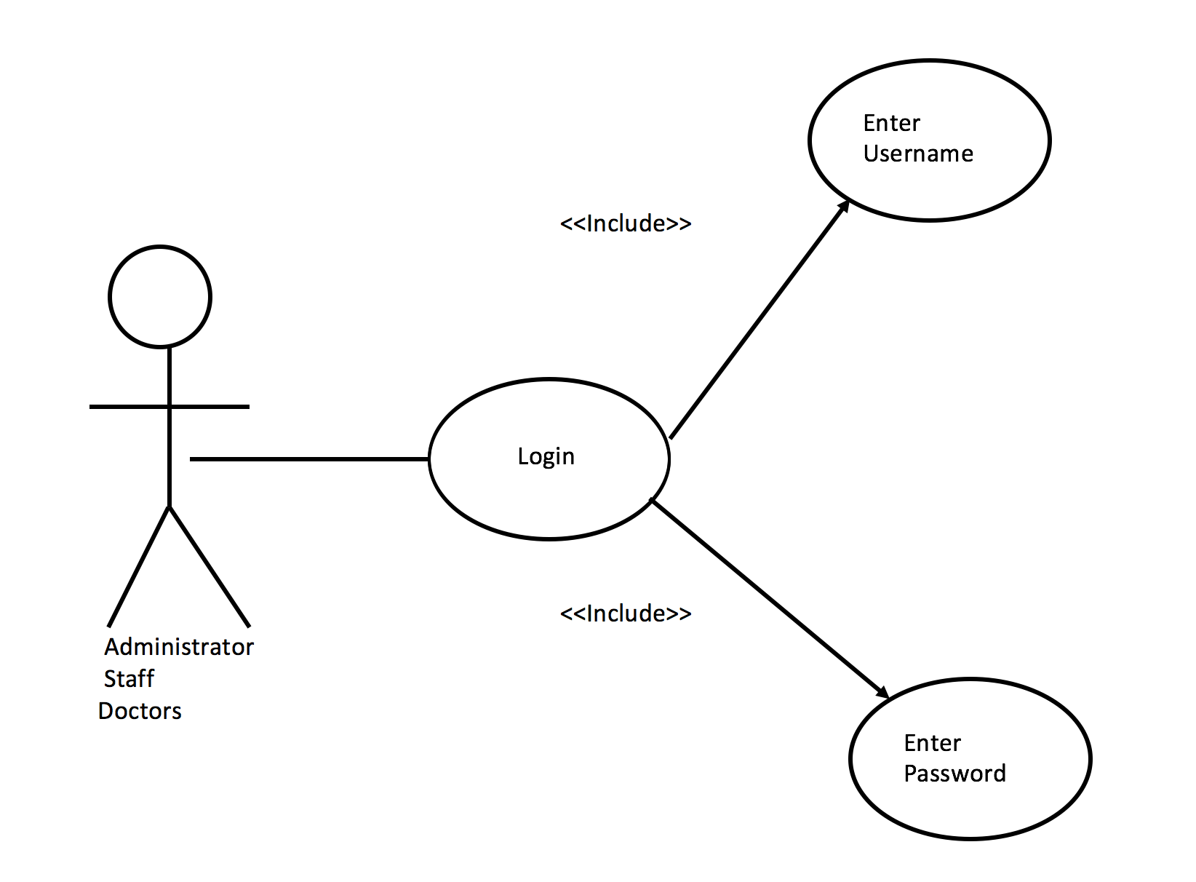
Use Case: Login
Login Page
Criteria:
Username
Password

Slide 11
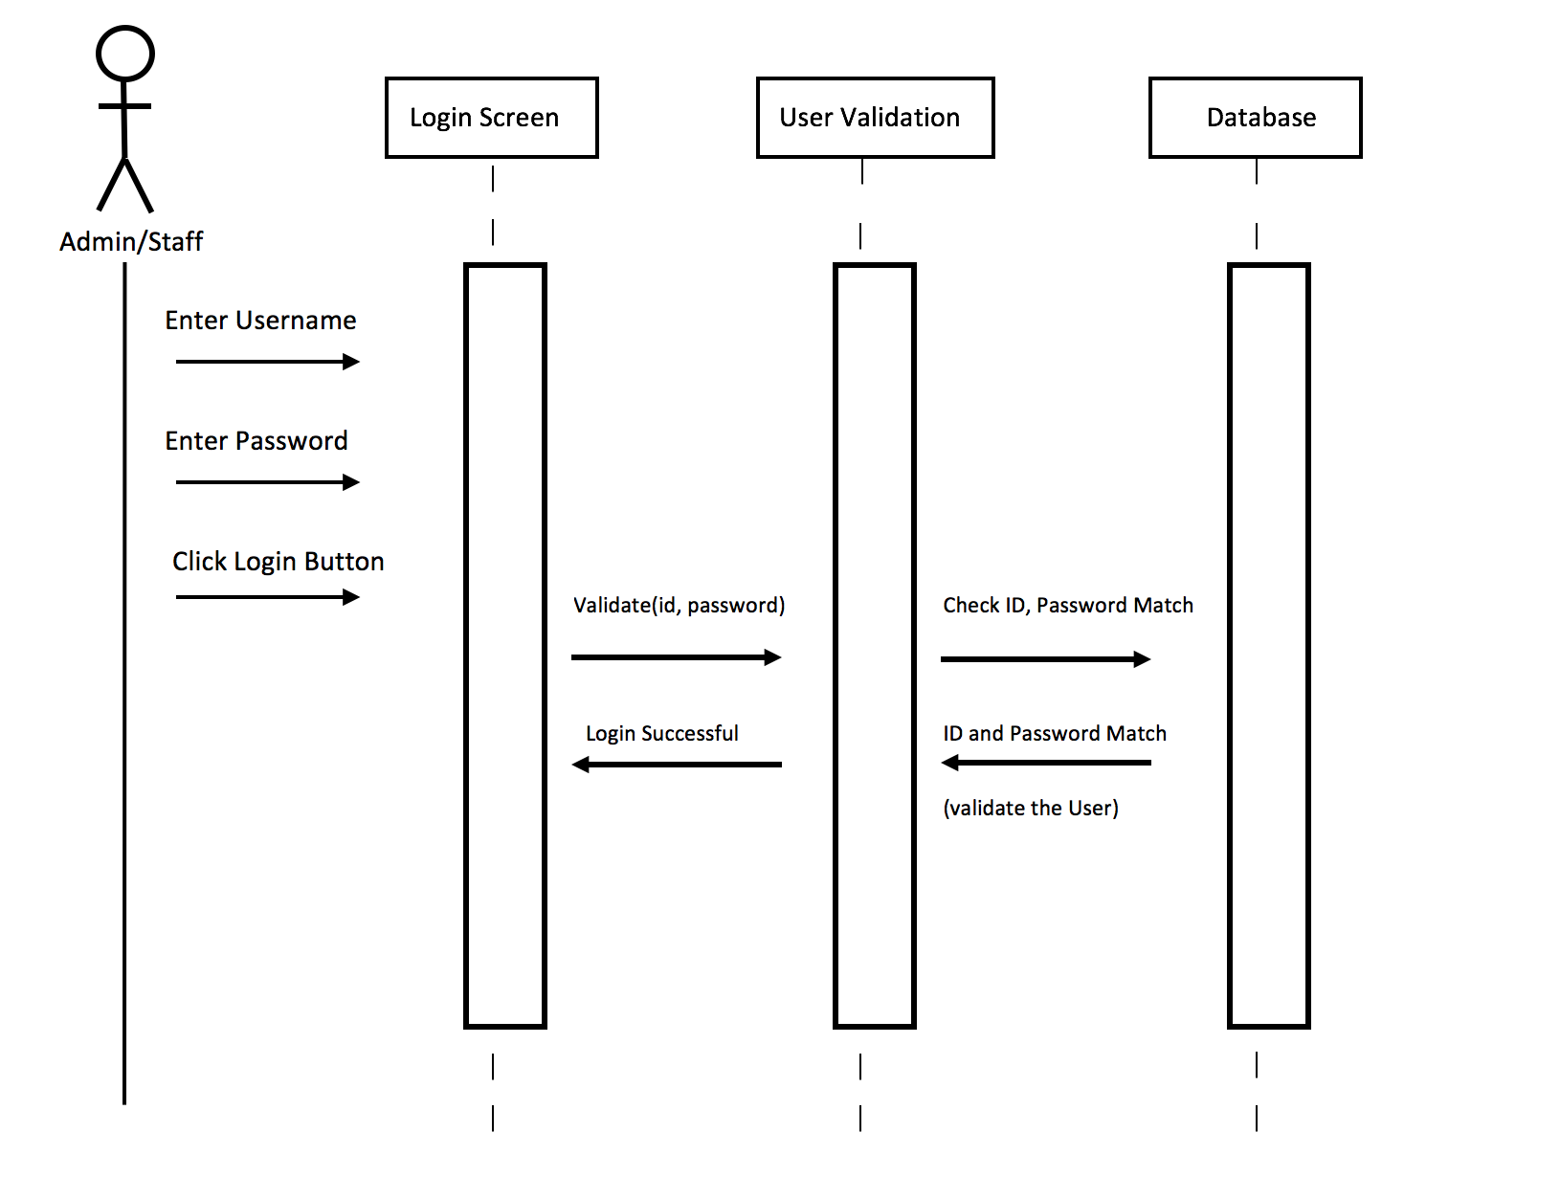
Sequence Diagram: Login
Item 2
Item 3

Slide 12
Use Case: Patient Information
Patient Information
Criteria:
Name
ID
Age
Contact

Slide 13
Sequence Diagram: Patient Information
Item 2
Item 3

Slide 14
Demonstration

Slide 15
Summary

